Slide 1
Laser Based Database :D
By Joshua Castaneda & Douglas Goss

Slide 2
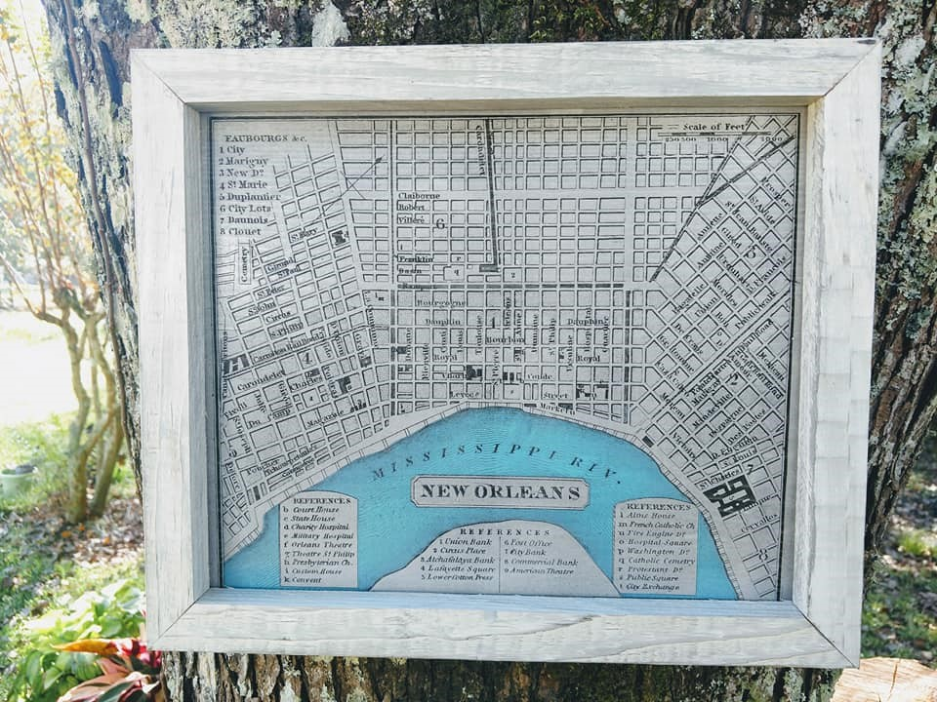
Client
Crafter of laser engraved 19th century Louisiana maps
Vendor to shops in Covington and New Orleans
Volume of about 200 per year

Slide 3
Client Requirements/Data Sources
Product management
Past invoices
Product prices based on shop
Receipts
Preferred materials and vendors
Mockaroo
Generate invoices to accompany shipment
Tracking of sales

Slide 4
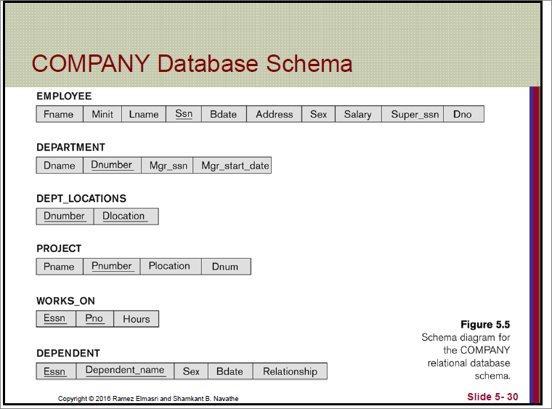
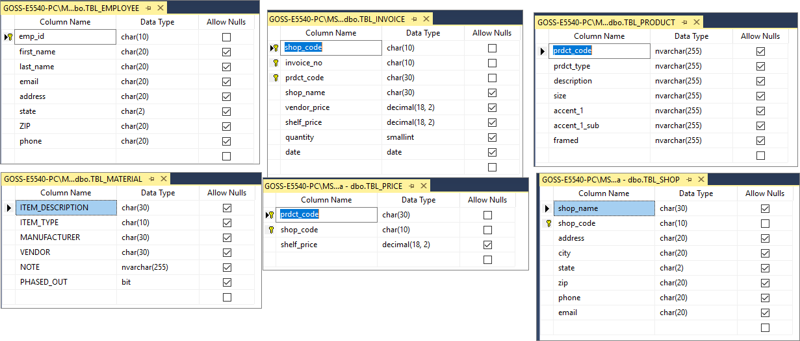
Translate screenshots into prettier ppt tables that resemble the schema from the book. Note the pk, fk and draw arcs btwn them.
Potential Relations and Attributes

Slide 5
Translate screenshots into prettier ppt tables that resemble the schema from the book. Note the pk, fk and draw arcs btwn them.
Potential Relations and Attributes

Slide 6
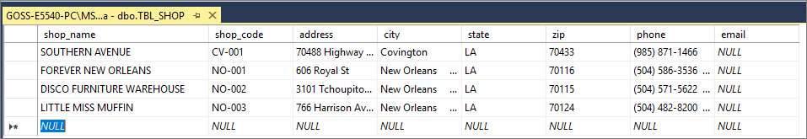
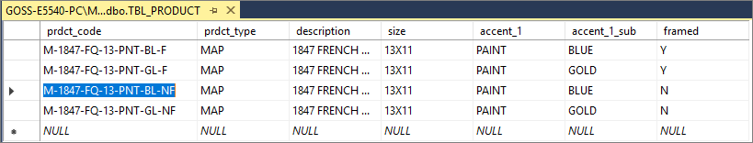
Relation Content Examples
Translate screenshots into prettier ppt tables.

Slide 7
Expected Timeline
Increase font size. Change text color to white.
Week 1 & 2 of project
Week 3 & 4 of project
Weeks 5 & 6 of project
Weeks 7 & 8 of project
1. Outlining the database needs/parameters
Thorough testing with practical use and routine
Early implementation and testing of database systems
Final errors being dealt with and overall polishing of finale product.

Slide 8
Member Roles
Increase font size. Add green bullets. Add goss primarily.
As of now, we plan on simply splitting the work 50/50.
Though once we get more into the specifics (more likely the specific problems) then we’ll delegate between ourselves accordingly.
But as for now...
50/50 sounds pretty fair.
Goss primarily determines needs as the client

